Slide 1
Cache Memories 15-213/18-213/15-513: Introduction to Computer Systems 12th Lecture, October 5, 2017
Today’s Instructor:
Phil Gibbons

Slide 2
Today
Cache memory organization and operation
Performance impact of caches
The memory mountain
Rearranging loops to improve spatial locality
Using blocking to improve temporal locality

Slide 3
Recall: Locality
Principle of Locality: Programs tend to use data and instructions with addresses near or equal to those they have used recently
Temporal locality:
Recently referenced items are likely to be referenced again in the near future
Spatial locality:
Items with nearby addresses tend to be referenced close together in time

Slide 4
Recall: Memory Hierarchy
L0:
Regs
CPU registers hold words retrieved from the L1 cache.
Smaller,
faster,
and
costlier
(per byte)
storage
devices
L1:
L1 cache
(SRAM)
L1 cache holds cache lines retrieved from the L2 cache.
L2:
L2 cache
(SRAM)
L2 cache holds cache lines
retrieved from L3 cache.
L3:
L3 cache
(SRAM)
L3 cache holds cache lines
retrieved from main memory.
Larger,
slower,
and
cheaper
(per byte)
storage
devices
L4:
Main memory
(DRAM)
Main memory holds disk blocks retrieved from local disks.
L5:
Local secondary storage
(local disks)
Local disks hold files retrieved from disks
on remote servers.
L6:
Remote secondary storage
(e.g., Web servers)

Slide 5
Recall: General Cache Concepts
Smaller, faster, more expensive
memory caches a subset of
the blocks
Cache
8
4
9
14
10
3
Data is copied in block-sized transfer units
4
10
Larger, slower, cheaper memory
viewed as partitioned into “blocks”
Memory
0
1
2
3
4
4
5
6
7
8
9
10
10
11
12
13
14
15

Slide 6
General Cache Concepts: Hit
Request: 14
Data in block b is needed
Block b is in cache:
Hit!
Cache
8
9
14
3
14
Memory
0
1
2
3
4
5
6
7
8
9
10
11
12
13
14
15

Slide 7
General Cache Concepts: Miss
Request: 12
Data in block b is needed
Block b is not in cache:
Miss!
Cache
8
9
14
3
12
Block b is fetched from
memory
12
Request: 12
Block b is stored in cache
Placement policy: determines where b goes
Replacement policy: determines which block gets evicted (victim)
Memory
0
1
2
3
4
5
6
7
8
9
10
11
12
12
13
14
15

Slide 8
General Caching Concepts: 3 Types of Cache Misses
Cold (compulsory) miss
Cold misses occur because the cache starts empty and this is the first reference to the block.
Capacity miss
Occurs when the set of active cache blocks (working set) is larger than the cache.
Conflict miss
Most caches limit blocks at level k+1 to a small subset (sometimes a singleton) of the block positions at level k.
E.g. Block i at level k+1 must be placed in block (i mod 4) at level k.
Conflict misses occur when the level k cache is large enough, but multiple data objects all map to the same level k block.
E.g. Referencing blocks 0, 8, 0, 8, 0, 8, ... would miss every time.

Slide 9
Cache Memories
Cache memories are small, fast SRAM-based memories managed automatically in hardware
Hold frequently accessed blocks of main memory
CPU looks first for data in cache
Typical system structure:
CPU chip
Register file
ALU
Cache
memory
System bus
Memory bus
Main
memory
Bus interface
I/O
bridge

Slide 10
Recall: Modern CPU Design
Instruction Control
Fetch
Control
Address
Instruction
Cache
Retirement
Unit
Register
File
Instruction
Decode
Instructions
Operations
Register Updates
Prediction OK?
Execution
Functional
Units
Branch
Arith
Arith
Arith
Load
Store
Operation Results
Addr.
Addr.
Data
Data
Data
Cache

Slide 11
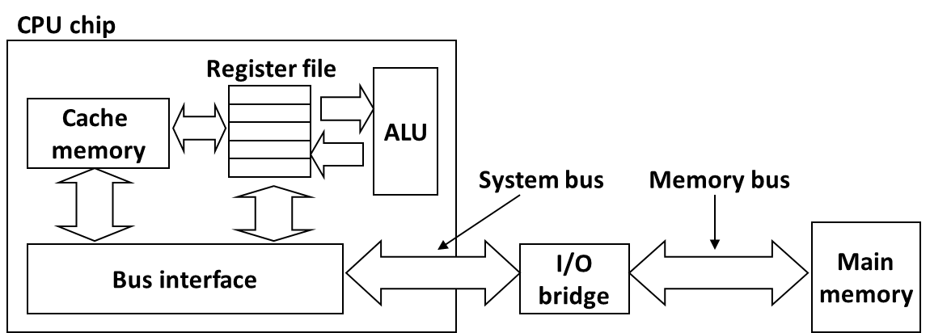

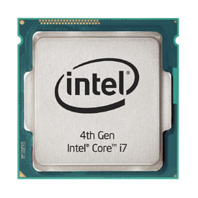
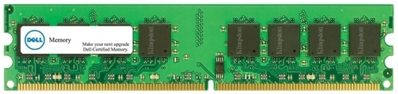
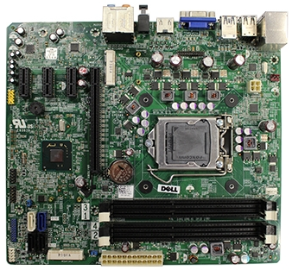
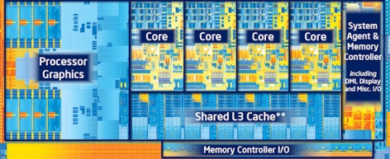
How it Really Looks Like
Desktop PC
CPU (Intel Core i7)
Main memory (DRAM)
Motherboard
Source: Dell
Source: Dell
Source: PC Magazine
Source: techreport.com
Source: Dell

Slide 12
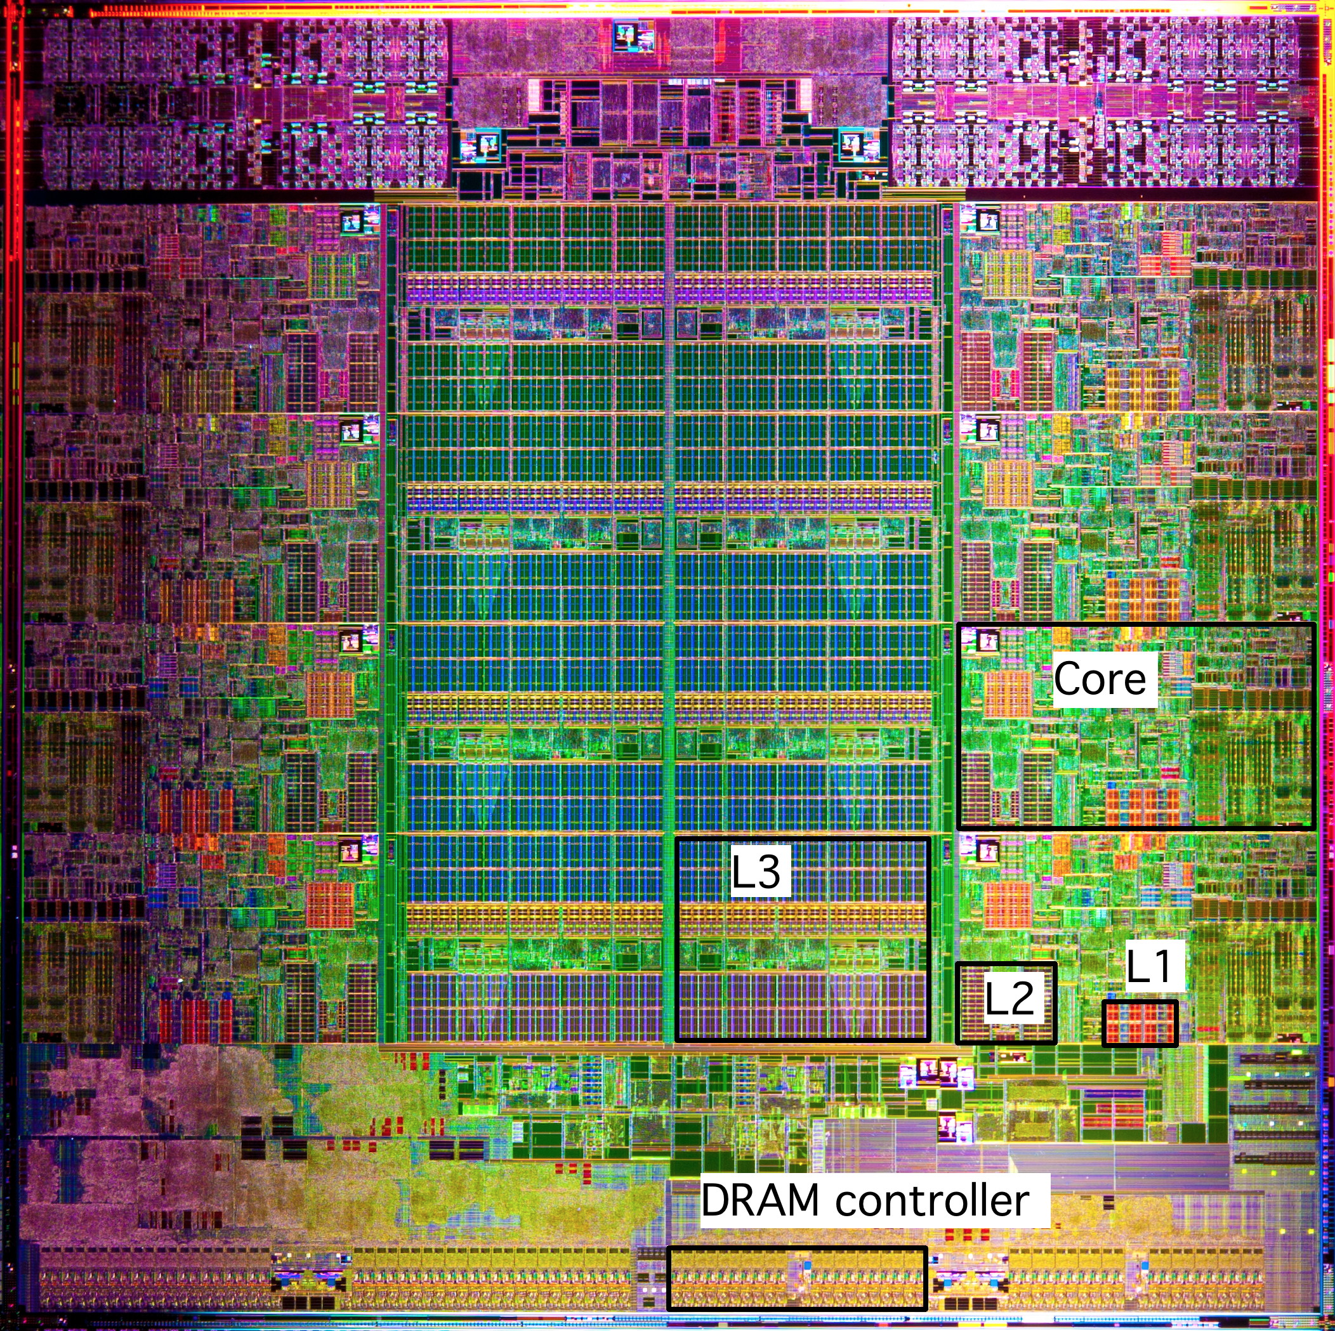
What it Really Looks Like (Cont.)
Intel Sandy Bridge
Processor Die
L1: 32KB Instruction + 32KB Data
L2: 256KB
L3: 3–20MB

Slide 13
General Cache Organization (S, E, B)
E = 2e lines per set
set
line
S = 2^{s} sets
Cache size:
C = S x E x B data bytes
v
tag
0
1
2
B-1
valid bit
B = 2^{b} bytes per cache block (the data)

Slide 14
Cache Read
Locate set
Check if any line in set has matching tag
Yes + line valid: hit
Locate data starting at offset
E = 2e lines per set
Address of word:
t bits
s bits
b bits
S = 2^{s} sets
tag
set
index
block
offset
data begins at this offset
v
tag
0
1
2
B-1
valid bit
B = 2^{b} bytes per cache block (the data)

Slide 15
Example: Direct Mapped Cache (E = 1)
Direct mapped: One line per set
Assume: cache block size B=8 bytes
Address of int:
v
tag
0
1
2
3
4
5
6
7
t bits
0…01
100
v
tag
0
1
2
3
4
5
6
7
find set
S = 2^{s} sets
v
tag
0
1
2
3
4
5
6
7
v
tag
0
1
2
3
4
5
6
7

Slide 16
Example: Direct Mapped Cache (E = 1)
Direct mapped: One line per set
Assume: cache block size B=8 bytes
Address of int:
valid? +
match: assume yes (= hit)
t bits
0…01
100
v
tag
0
1
2
3
4
5
6
7
tag
block offset

Slide 17
Example: Direct Mapped Cache (E = 1)
Direct mapped: One line per set
Assume: cache block size B=8 bytes
Address of int:
valid? +
match: assume yes (= hit)
t bits
0…01
100
v
tag
0
1
2
3
4
5
6
7
block offset
int (4 Bytes) is here
If tag doesn’t match (= miss): old line is evicted and replaced

Slide 18
Direct-Mapped Cache Simulation
t=1
s=2
b=1
M=16 bytes (4-bit addresses), B=2 bytes/block,
S=4 sets, E=1 Blocks/set
Address trace (reads, one byte per read):
0 [0000₂],
1 [0001₂],
7 [0111₂],
8 [1000₂],
0 [0000₂]
x
xx
x
miss
hit
miss
miss
miss
v
Tag
Block
Set 0
0
?
?
1
1
1
0
1
0
M[0-1]
M[8-9]
M[0-1]
Set 1
Set 2
Set 3
1
0
M[6-7]

Slide 19
E-way Set Associative Cache (Here: E = 2)
E = 2: Two lines per set
Assume: cache block size B=8 bytes
Address of short int:
2 lines per set
t bits
0…01
100
v
tag
0
1
2
3
4
5
6
7
v
tag
0
1
2
3
4
5
6
7
v
tag
0
1
2
3
4
5
6
7
v
tag
0
1
2
3
4
5
6
7
find set
v
tag
0
1
2
3
4
5
6
7
v
tag
0
1
2
3
4
5
6
7
v
tag
0
1
2
3
4
5
6
7
v
tag
0
1
2
3
4
5
6
7
S sets

Slide 20
E-way Set Associative Cache (Here: E = 2)
E = 2: Two lines per set
Assume: cache block size B=8 bytes
Address of short int:
compare both
t bits
0…01
100
valid? +
match: yes (= hit)
v
tag
0
1
2
3
4
5
6
7
tag
v
tag
0
1
2
3
4
5
6
7
block offset

Slide 21
E-way Set Associative Cache (Here: E = 2)
E = 2: Two lines per set
Assume: cache block size B=8 bytes
Address of short int:
compare both
t bits
0…01
100
valid? +
match: yes (= hit)
v
tag
0
1
2
3
4
5
6
7
v
tag
0
1
2
3
4
5
6
7
block offset
short int (2 Bytes) is here
No match (= miss):
One line in set is selected for eviction and replacement
Replacement policies: random, least recently used (LRU), …

Slide 22
2-Way Set Associative Cache Simulation
t=2
s=1
b=1
xx
x
x
M=16 byte addresses, B=2 bytes/block,
S=2 sets, E=2 blocks/set
Address trace (reads, one byte per read):
0 [0000₂],
1 [0001₂],
7 [0111₂],
8 [1000₂],
0 [0000₂]
miss
hit
miss
miss
hit
v
Tag
Block
0
?
?
Set 0
1
00
M[0-1]
1
10
M[8-9]
0
1
01
M[6-7]
Set 1
0
0

Slide 23
What about writes?
Multiple copies of data exist:
L1, L2, L3, Main Memory, Disk
What to do on a write-hit?
Write-through (write immediately to memory)
Write-back (defer write to memory until replacement of line)
Each cache line needs a dirty bit (line different from memory or not)
What to do on a write-miss?
Write-allocate (load into cache, update line in cache)
Good if more writes to the location follow
No-write-allocate (writes straight to memory, does not load into cache)
Typical
Write-through + No-write-allocate
Write-back + Write-allocate
v
d
tag
0
1
2
B-1
valid bit
dirty bit
B = 2^{b} bytes

Slide 24
Why Index Using Middle Bits?
Direct mapped: One line per set
Assume: cache block size 8 bytes
Standard Method:
Middle bit indexing
Address of int:
v
tag
0
1
2
3
4
5
6
7
t bits
0…01
100
v
tag
0
1
2
3
4
5
6
7
find set
S = 2^{s} sets
v
tag
0
1
2
3
4
5
6
7
Alternative Method:
High bit indexing
Address of int:
v
tag
0
1
2
3
4
5
6
7
1…11
t bits
100
find set

Slide 25
Illustration of Indexing Approaches
0000xx
0001xx
0010xx
64-byte memory
6-bit addresses
16 byte, direct-mapped cache
Block size = 4 (4 sets)
2 bits tag, 2 bits index, 2 bits offset
0011xx
0100xx
0101xx
0110xx
0111xx
1000xx
1001xx
Set 0
1010xx
Set 1
1011xx
Set 2
1100xx
Set 3
1101xx
1110xx
1111xx

Slide 26
Middle Bit Indexing
0000xx
0001xx
0010xx
Addresses of form TTSSBB
TT Tag bits
SS Set index bits
BB Offset bits
Makes good use of spatial locality
0011xx
0100xx
0101xx
0110xx
0111xx
1000xx
1001xx
Set 0
1010xx
Set 1
1011xx
Set 2
1100xx
Set 3
1101xx
1110xx
1111xx

Slide 27
High Bit Indexing
0000xx
0001xx
0010xx
Addresses of form SSTTBB
SS Set index bits
TT Tag bits
BB Offset bits
Program with high spatial locality would generate lots of conflicts
0011xx
0100xx
0101xx
0110xx
0111xx
1000xx
1001xx
Set 0
1010xx
Set 1
1011xx
Set 2
1100xx
Set 3
1101xx
1110xx
1111xx

Slide 28
Intel Core i7 Cache Hierarchy
Processor package
Core 0
Core 3
L1 i-cache and d-cache:
32 KB, 8-way,
Access: 4 cycles
L2 unified cache:
256 KB, 8-way,
Access: 10 cycles
L3 unified cache:
8 MB, 16-way,
Access: 40-75 cycles
Block size: 64 bytes for all caches.
Regs
Regs
L1
d-cache
L1
i-cache
L1
d-cache
L1
i-cache
…
L2 unified cache
L2 unified cache
L3 unified cache
(shared by all cores)
Main memory

Slide 29
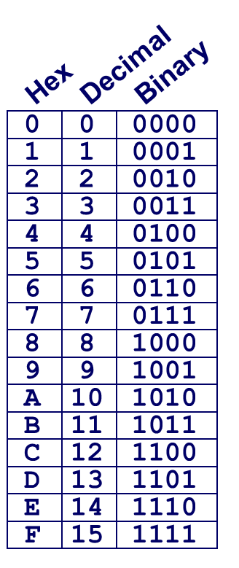
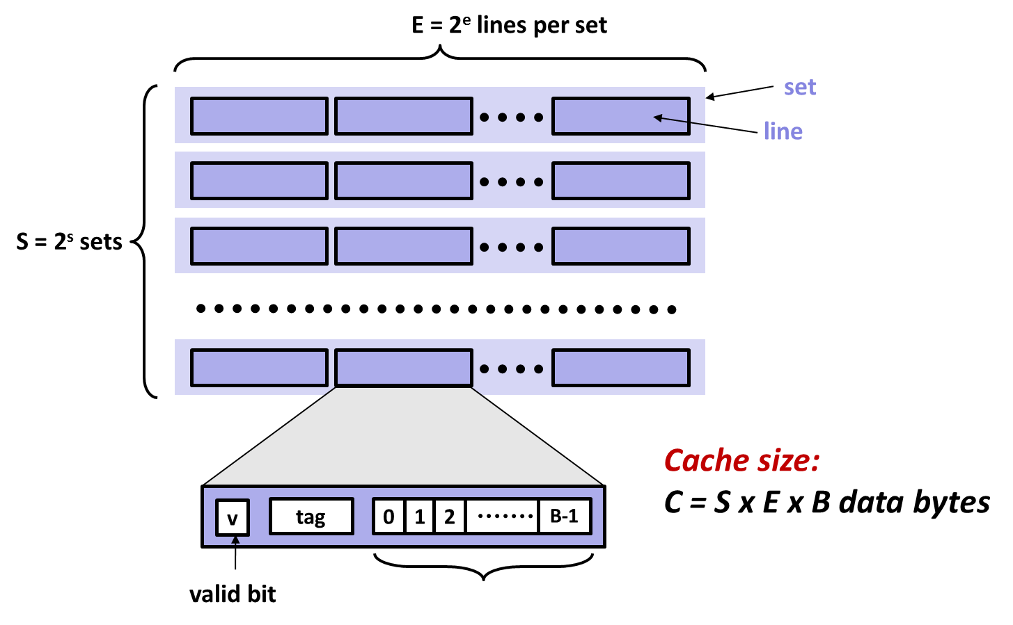
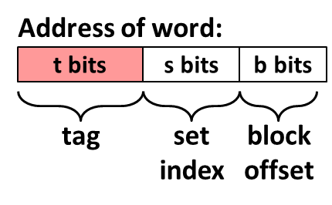
Example: Core i7 L1 Data Cache
32 kB 8-way set associative
64 bytes/block
47 bit address range
B =
S = , s =
E = , e =
C =
Stack Address: 0x00007f7262a1e010
Block offset: 0x??
Set index: 0x??
Tag: 0x??
Block offset: . bits
Set index: . bits
Tag: . bits

Slide 30
Example: Core i7 L1 Data Cache
32 kB 8-way set associative 64 bytes/block
47 bit address range
B = 64
S = 64, s = 6
E = 8, e = 3
C = 64 x 64 x 8 = 32,768
Stack Address: 0x00007f7262a1e010
Block offset: 0x10
Set index: 0x0
Tag: 0x7f7262a1e
Block offset: 6 bits
Set index: 6 bits
Tag: 35 bits
0000 0001 0000

Slide 31
Cache Performance Metrics
Miss Rate
Fraction of memory references not found in cache (misses / accesses) = 1 – hit rate
Typical numbers (in percentages):
3-10% for L1
can be quite small (e.g., < 1%) for L2, depending on size, etc.
Hit Time
Time to deliver a line in the cache to the processor
includes time to determine whether the line is in the cache
Typical numbers:
4 clock cycle for L1
10 clock cycles for L2
Miss Penalty
Additional time required because of a miss
typically 50-200 cycles for main memory (Trend: increasing!)

Slide 32
Let’s think about those numbers
Huge difference between a hit and a miss
Could be 100x, if just L1 and main memory
Would you believe 99% hits is twice as good as 97%?
Consider this simplified example: cache hit time of 1 cycle miss penalty of 100 cycles
Average access time:
97% hits: 1 cycle + 0.03 x 100 cycles = 4 cycles
99% hits: 1 cycle + 0.01 x 100 cycles = 2 cycles
This is why “miss rate” is used instead of “hit rate”

Slide 33
Writing Cache Friendly Code
Make the common case go fast
Focus on the inner loops of the core functions
Minimize the misses in the inner loops
Repeated references to variables are good (temporal locality)
Stride-1 reference patterns are good (spatial locality)
Key idea: Our qualitative notion of locality is quantified through our understanding of cache memories

Slide 34
Quiz Time!
Check out:
https://canvas.cmu.edu/courses/1221

Slide 35
Today
Cache organization and operation
Performance impact of caches
The memory mountain
Rearranging loops to improve spatial locality
Using blocking to improve temporal locality

Slide 36
The Memory Mountain
Read throughput (read bandwidth)
Number of bytes read from memory per second (MB/s)
Memory mountain: Measured read throughput as a function of spatial and temporal locality.
Compact way to characterize memory system performance.

Slide 37
Memory Mountain Test Function
long data[MAXELEMS]; /* Global array to traverse */
/* test - Iterate over first "elems" elements of
* array "data" with stride of "stride“,
* using 4x4 loop unrolling.
*/
int test(int elems, int stride) {
long i, sx2=stride*2, sx3=stride*3, sx4=stride*4;
long acc0 = 0, acc1 = 0, acc2 = 0, acc3 = 0;
long length = elems, limit = length - sx4;
/* Combine 4 elements at a time */
for (i = 0; i < limit; i += sx4) {
acc0 = acc0 + data[i];
acc1 = acc1 + data[i+stride];
acc2 = acc2 + data[i+sx2];
acc3 = acc3 + data[i+sx3];
}
/* Finish any remaining elements */
for (; i < length; i++) {
acc0 = acc0 + data[i];
}
return ((acc0 + acc1) + (acc2 + acc3));
}
Call test() with many combinations of elems
and stride.
For each elems and stride:
1. Call test() once to warm up the caches.
2. Call test() again and measure the read throughput(MB/s)
mountain/mountain.c

Slide 38
The Memory Mountain
Core i7 Haswell
2.1 GHz
32 KB L1 d-cache
256 KB L2 cache
8 MB L3 cache
64 B block size
Aggressive prefetching
L1
Ridges
of temporal locality
L2
L3
Slopes
of spatial locality
Mem

Slide 39
Today
Cache organization and operation
Performance impact of caches
The memory mountain
Rearranging loops to improve spatial locality
Using blocking to improve temporal locality

Slide 40
Matrix Multiplication Example
Description:
Multiply N x N matrices
Matrix elements are doubles (8 bytes)
O(N³) total operations
N reads per source element
N values summed per destination
but may be able to hold in register
Variable sum
held in register
/* ijk */
for (i=0; i<n; i++) {
for (j=0; j<n; j++) {
sum = 0.0;
for (k=0; k<n; k++)
sum += a[i][k] * b[k][j];
c[i][j] = sum;
}
}
matmult/mm.c

Slide 41
Miss Rate Analysis for Matrix Multiply
Assume:
Block size = 32B (big enough for four doubles)
Matrix dimension (N) is very large
Approximate 1/N as 0.0
Cache is not even big enough to hold multiple rows
Analysis Method:
Look at access pattern of inner loop
j
k
j
=
x
i
i
k
C
A
B

Slide 42
Layout of C Arrays in Memory (review)
C arrays allocated in row-major order
each row in contiguous memory locations
Stepping through columns in one row:
for (i = 0; i < N; i++)
sum += a[0][i];
accesses successive elements
if block size (B) > sizeof(a_{ij}) bytes, exploit spatial locality
miss rate = sizeof(a_{ij}) / B
Stepping through rows in one column:
for (i = 0; i < n; i++)
sum += a[i][0];
accesses distant elements
no spatial locality!
miss rate = 1 (i.e. 100%)

Slide 43
Matrix Multiplication (ijk)
/* ijk */
for (i=0; i<n; i++) {
for (j=0; j<n; j++) {
sum = 0.0;
for (k=0; k<n; k++)
sum += a[i][k] * b[k][j];
c[i][j] = sum;
}
}
Inner loop:
(*,j)
(i,j)
(i,*)
A
B
C
matmult/mm.c
Row-wise
Column-
wise
Fixed
Misses per inner loop iteration:
A B C
0.25 1.0 0.0
Block size = 32B (four doubles)

Slide 44
Matrix Multiplication (kij)
/* kij */
for (k=0; k<n; k++) {
for (i=0; i<n; i++) {
r = a[i][k];
for (j=0; j<n; j++)
c[i][j] += r * b[k][j];
}
}
Inner loop:
(i,k)
(k,*)
(i,*)
A
B
C
matmult/mm.c
Fixed
Row-wise
Row-wise
Misses per inner loop iteration:
A B C
0.0 0.25 0.25
Block size = 32B (four doubles)

Slide 45
Matrix Multiplication (jki)
Inner loop:
/* jki */
for (j=0; j<n; j++) {
for (k=0; k<n; k++) {
r = b[k][j];
for (i=0; i<n; i++)
c[i][j] += a[i][k] * r;
}
}
(*,k)
(*,j)
(k,j)
A
B
C
matmult/mm.c
Column-
wise
Fixed
Column-
wise
Misses per inner loop iteration:
A B C
1.0 0.0 1.0
Block size = 32B (four doubles)

Slide 46
Summary of Matrix Multiplication
for (i=0; i<n; i++) {
for (j=0; j<n; j++) {
sum = 0.0;
for (k=0; k<n; k++)
sum += a[i][k] * b[k][j];
c[i][j] = sum;
}
}
ijk (& jik):
2 loads, 0 stores
misses/iter = 1.25
for (k=0; k<n; k++) {
for (i=0; i<n; i++) {
r = a[i][k];
for (j=0; j<n; j++)
c[i][j] += r * b[k][j];
}
}
kij (& ikj):
2 loads, 1 store
misses/iter = 0.5
for (j=0; j<n; j++) {
for (k=0; k<n; k++) {
r = b[k][j];
for (i=0; i<n; i++)
c[i][j] += a[i][k] * r;
}
}
jki (& kji):
2 loads, 1 store
misses/iter = 2.0

Slide 47
Core i7 Matrix Multiply Performance
Cycles per inner loop iteration
jki / kji
ijk / jik
kij / ikj

Slide 48
Today
Cache organization and operation
Performance impact of caches
The memory mountain
Rearranging loops to improve spatial locality
Using blocking to improve temporal locality

Slide 49
Example: Matrix Multiplication
c = (double *) calloc(sizeof(double), n*n);
/* Multiply n x n matrices a and b */
void mmm(double *a, double *b, double *c, int n) {
int i, j, k;
for (i = 0; i < n; i++)
for (j = 0; j < n; j++)
for (k = 0; k < n; k++)
c[i*n + j] += a[i*n + k] * b[k*n + j];
}
j
c
a
b
=
x
i

Slide 50
Cache Miss Analysis
Assume:
Matrix elements are doubles
Cache block = 8 doubles
Cache size C << n (much smaller than n)
First iteration:
n/8 + n = 9n/8 misses
Afterwards in cache: (schematic)
n
=
x
=
x
8 wide

Slide 51
Cache Miss Analysis
Assume:
Matrix elements are doubles
Cache block = 8 doubles
Cache size C << n (much smaller than n)
Second iteration:
Again: n/8 + n = 9n/8 misses
Total misses:
9n/8 n² = (9/8) n³
n
=
x
8 wide

Slide 52
Blocked Matrix Multiplication
c = (double *) calloc(sizeof(double), n*n);
/* Multiply n x n matrices a and b */
void mmm(double *a, double *b, double *c, int n) {
int i, j, k;
for (i = 0; i < n; i+=B)
for (j = 0; j < n; j+=B)
for (k = 0; k < n; k+=B)
/* B x B mini matrix multiplications */
for (i1 = i; i1 < i+B; i++)
for (j1 = j; j1 < j+B; j++)
for (k1 = k; k1 < k+B; k++)
c[i1*n+j1] += a[i1*n + k1]*b[k1*n + j1];
}
matmult/bmm.c
j1
c
a
b
c
=
x
+
i1
Block size B x B

Slide 53
Cache Miss Analysis
Assume:
Cache block = 8 doubles
Cache size C << n (much smaller than n)
Three blocks fit into cache: 3B² < C
First (block) iteration:
B²/8 misses for each block
2n/B x B²/8 = nB/4 (omitting matrix c)
Afterwards in cache (schematic)
n/B blocks
=
x
Block size B x B
=
x

Slide 54
Cache Miss Analysis
Assume:
Cache block = 8 doubles
Cache size C << n (much smaller than n)
Three blocks fit into cache: 3B² < C
Second (block) iteration:
Same as first iteration
2n/B x B²/8 = nB/4
Total misses:
nB/4 * (n/B)² = n³/(4B)
n/B blocks
=
x
Block size B x B

Slide 55
Blocking Summary
No blocking: (9/8) n³
Blocking: 1/(4B) n³
Suggests using largest possible block size B, but limit 3B² < C!
Reason for dramatic difference:
Matrix multiplication has inherent temporal locality:
Input data: 3n², computation 2n³
Every array elements used O(n) times!
But program has to be written properly

Slide 56
Cache Summary
Cache memories can have significant performance impact
You can write your programs to exploit this!
Focus on the inner loops, where bulk of computations and memory accesses occur.
Try to maximize spatial locality by reading data objects sequentially with stride 1.
Try to maximize temporal locality by using a data object as often as possible once it’s read from memory.

Slide 57
Supplemental slides

Slide 58
The Memory Mountain
Core i5 Haswell
3.1 GHz
32 KB L1 d-cache
256 KB L2 cache
8 MB L3 cache
64 B block size
Aggressive prefetching
L1
Ridges
of temporal locality
L2
L3
Slopes
of spatial locality
Mem

Slide 59
Cache Capacity Effects from Memory Mountain
Core i7 Haswell
3.1 GHz
32 KB L1 d-cache
256 KB L2 cache
8 MB L3 cache
64 B block size
Main Memory
L3
L2
L1
Slice through memory mountain with stride=8

Slide 60
Cache Block Size Effects from Memory Mountain
Core i7 Haswell
2.26 GHz
32 KB L1 d-cache
256 KB L2 cache
8 MB L3 cache
64 B block size
Miss rate = s/8
Miss rate = 1.0
Stride s

Slide 61
Modeling Block Size Effects from Memory Mountain
Core i7 Haswell
2.26 GHz
32 KB L1 d-cache
256 KB L2 cache
8 MB L3 cache
64 B block size
Stride s

Slide 62
2008 Memory Mountain
Core 2 Duo
2.4 GHz
32 KB L1 d-cache
6MB L2 cache
64 B block size
No prefetching

Slide 63
Matrix Multiplication (jik)
/* jik */
for (j=0; j<n; j++) {
for (i=0; i<n; i++) {
sum = 0.0;
for (k=0; k<n; k++)
sum += a[i][k] * b[k][j];
c[i][j] = sum
}
}
Inner loop:
(*,j)
(i,j)
(i,*)
A
B
C
matmult/mm.c
Row-wise
Column-
wise
Fixed
Misses per inner loop iteration:
A B C
0.25 1.0 0.0
Block size = 32B (four doubles)

Slide 64
Matrix Multiplication (ikj)
/* ikj */
for (i=0; i<n; i++) {
for (k=0; k<n; k++) {
r = a[i][k];
for (j=0; j<n; j++)
c[i][j] += r * b[k][j];
}
}
Inner loop:
(i,k)
(k,*)
(i,*)
A
B
C
matmult/mm.c
Fixed
Row-wise
Row-wise
Misses per inner loop iteration:
A B C
0.0 0.25 0.25
Block size = 32B (four doubles)

Slide 65
Matrix Multiplication (kji)
/* kji */
for (k=0; k<n; k++) {
for (j=0; j<n; j++) {
r = b[k][j];
for (i=0; i<n; i++)
c[i][j] += a[i][k] * r;
}
}
Inner loop:
(*,k)
(*,j)
(k,j)
A
B
C
matmult/mm.c
Column-
wise
Fixed
Column-
wise
Misses per inner loop iteration:
A B C
1.0 0.0 1.0
Block size = 32B (four doubles)

